Slide 1


SOCIAL MEDIA APPLICATION PYTHON SPECIALIZATION TRAINING PROJECT
TEAM:YELLOW
ROHAN ANAND : 6536
RUCHITHA NUKALA : 6555
SAHITHI DAMERA : 6557
SHIREESHA BUDUMURU : 6539

Slide 2
INTRODUCTION:
Social Media : The quality of our interpersonal relationships.
While social media provides easier and more accessible opportunities to interact with others, how we communicate and interact hinders the quality of more interwoven into daily life, the use of the Internet and/or social media becomes a higher priority” our interpersonal relationships. The quality of interpersonal relationships is at risk because “as the Internet is becoming more interwoven into daily life.
The usage of social media is deemed more important because users are able to easily interact and communicate with those in their social network by just liking a photo on Instagram or commenting on a post on Facebook.. College students are frequently checking and updating their social networking sites daily in order to stay connected with friends and family back home. Even in friendships, individuals believe that if you are friends on Facebook or followers on Instagram and Twitter that you are friends in real life. As a result, social media can ultimately affect interpersonal relationships when we choose to allow them to control our communication in a relationship.. Hence, causing the quality of relationships to deteriorate and “weak ties” in a relationship to develop.

Slide 3
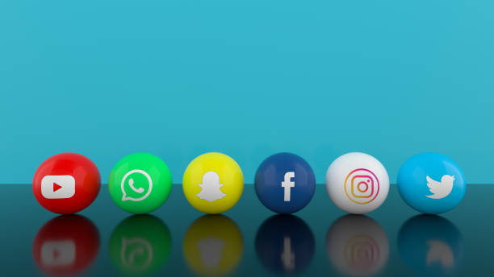




SOFTWARE USED:
FRONTEND:
HTML
CSS
JAVASCRIPT
FRAMEWORK:
DJANGO
BACKEND:
DBSQLITE
PYTHON
HOSTING

Slide 4







ARCHITECTURAL DESIGN:

Slide 5
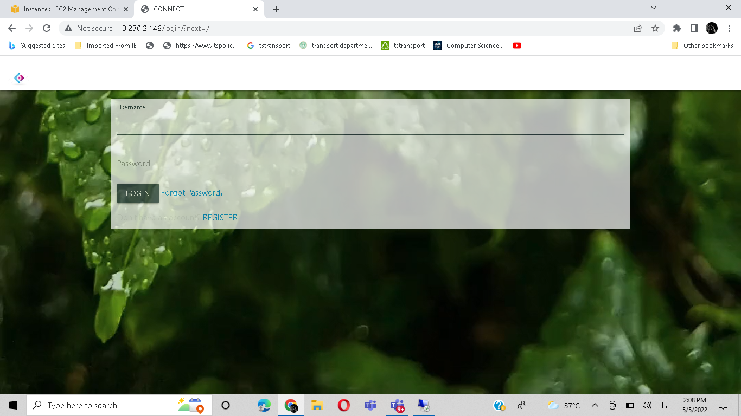
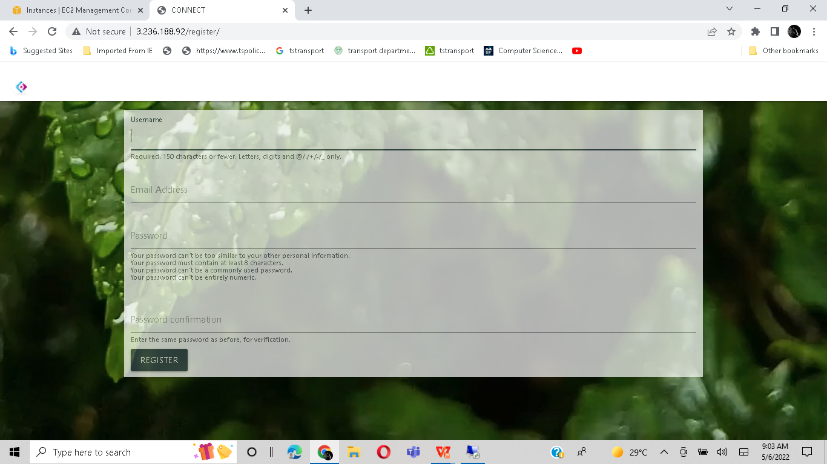
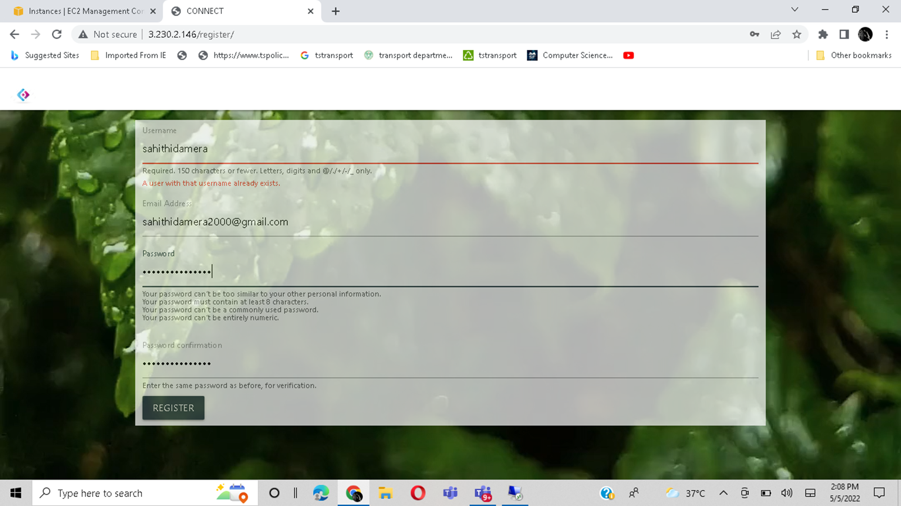
SAMPLE SCREENSHOTS OF PROJECT:

Slide 6
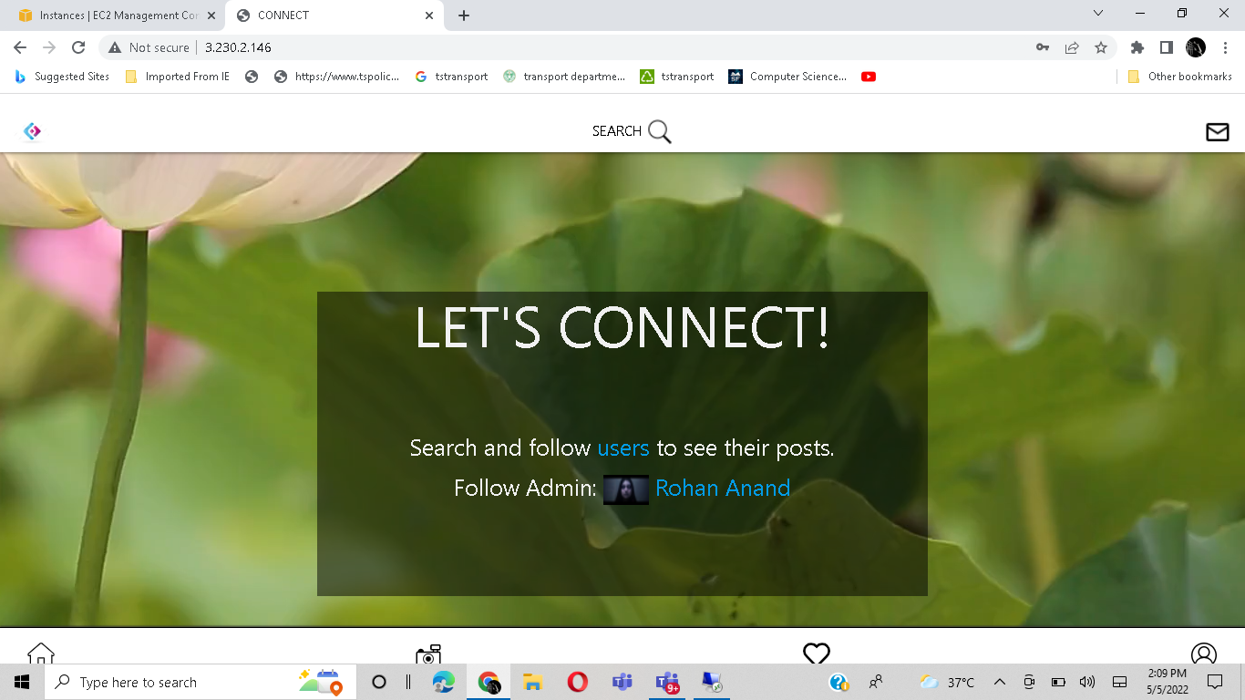

Slide 7
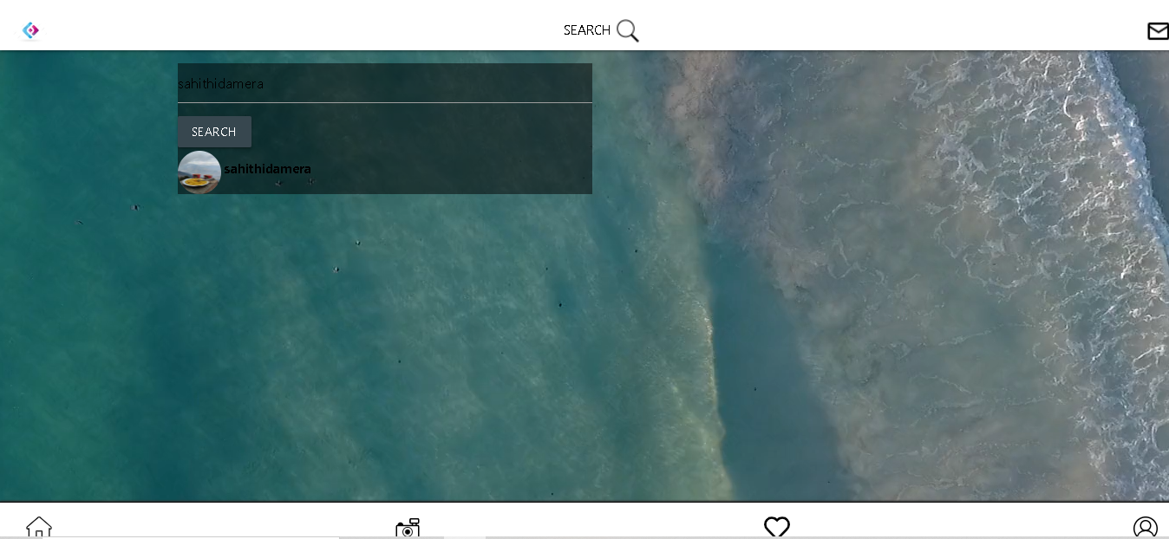
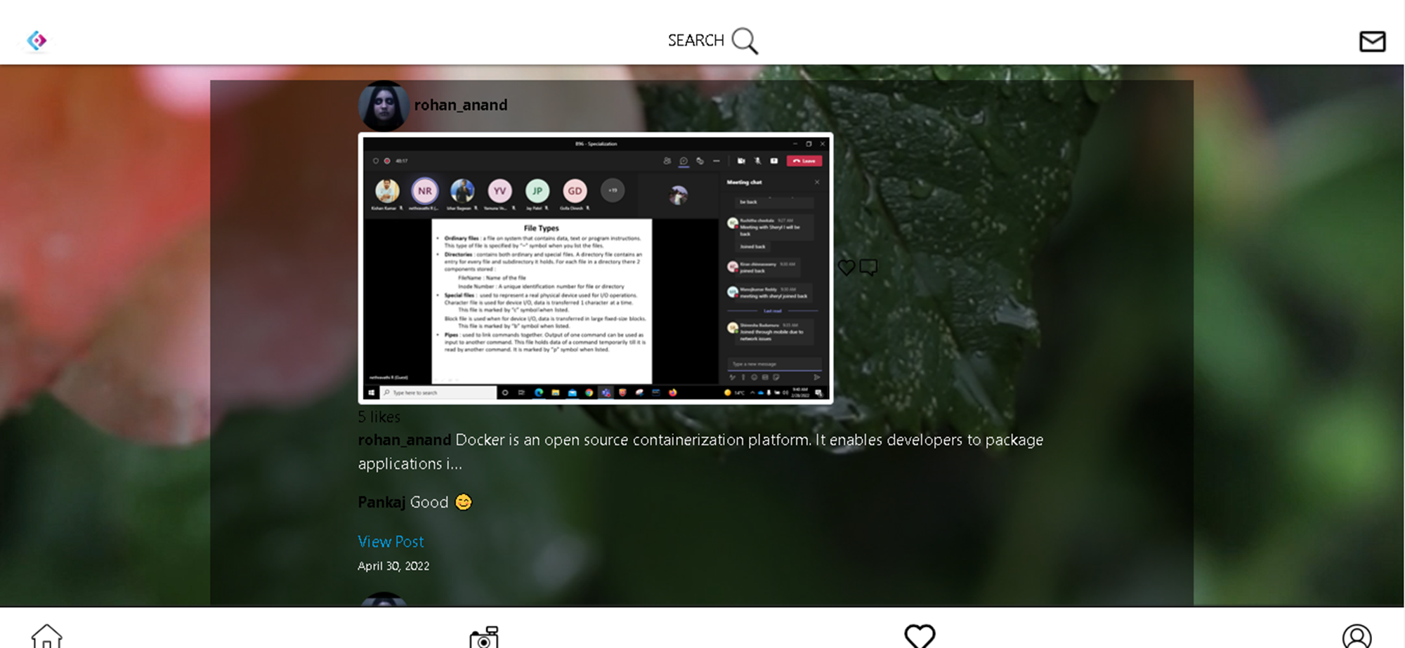
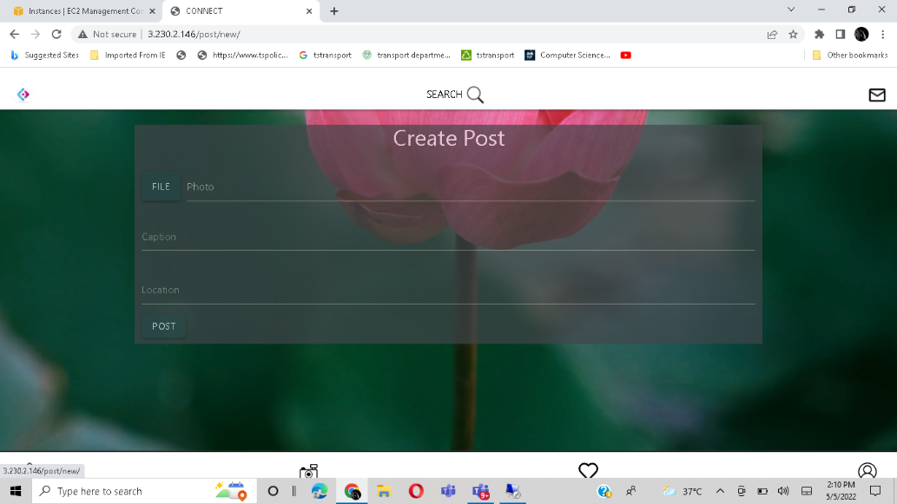
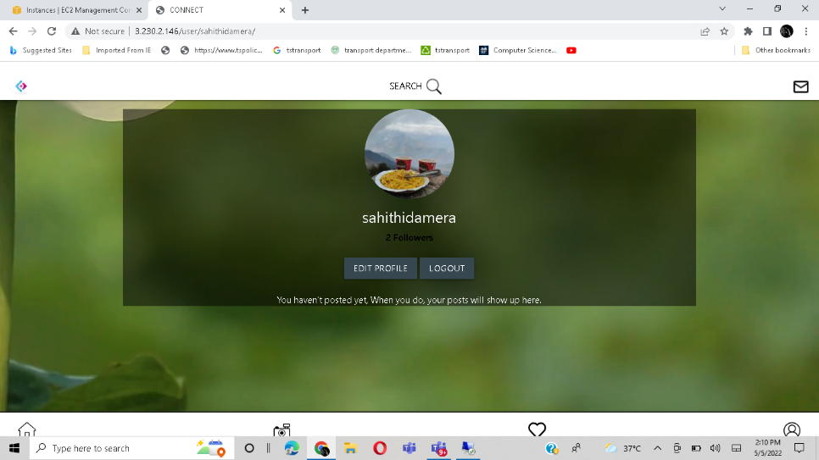

Slide 8
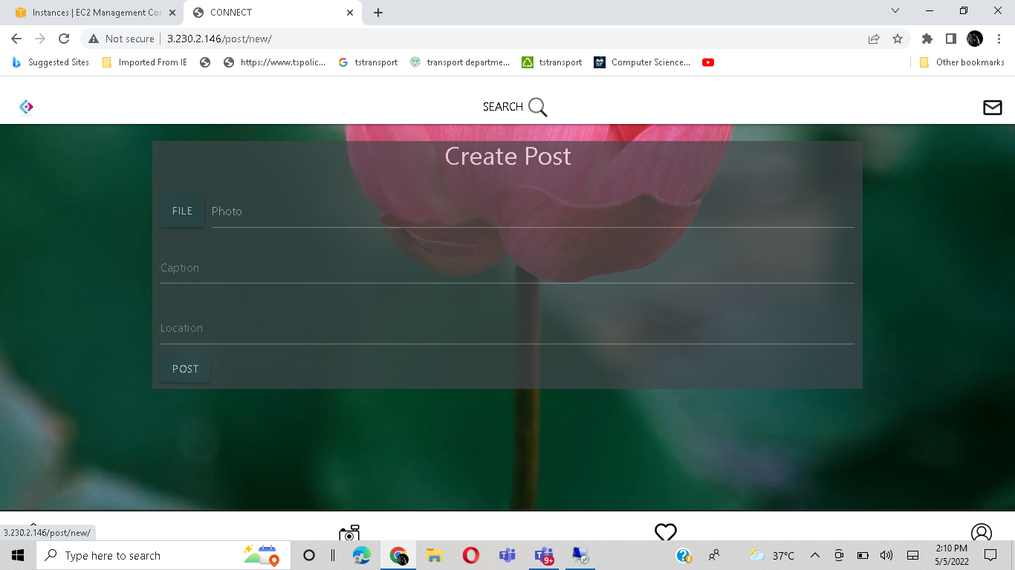
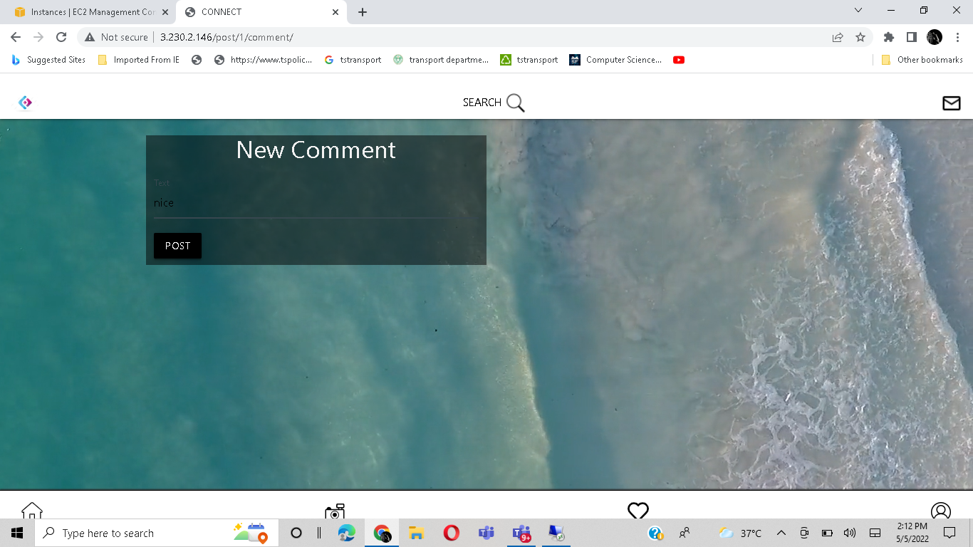
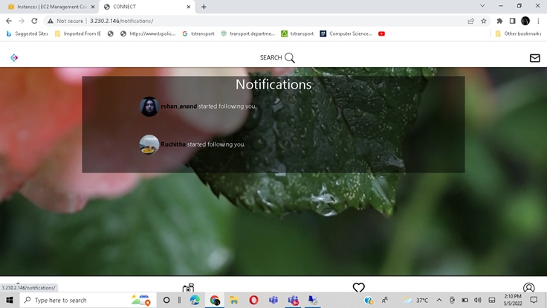

Slide 9
THANKYOU

